Slide 1
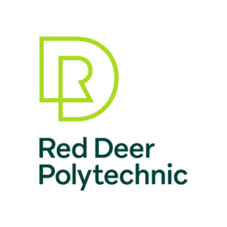
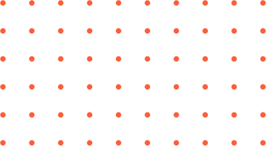

Google Colab, Jupyter Notebook, & Kaggle
Module 1
by Todd Nash

Slide 2

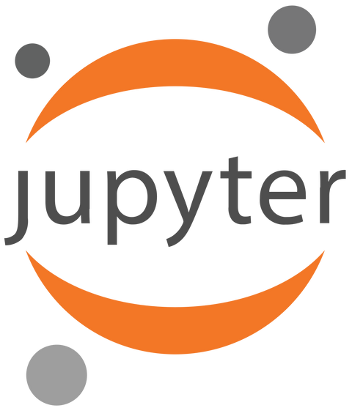

Google Colab, Jupyter Notebook, and Kaggle are all platforms/tools commonly used in the field of data science, machine learning, and scientific computing. Each serves specific purposes and has unique features.
by Todd Nash
by Todd Nash

Slide 3
Jupyter Notebook is an open-source, interactive web application that allows you to create and share documents that contain live code, equations, visualizations, and narrative text. It supports various programming languages, but it is widely used with Python.
Features:
Interactive and exploratory data analysis with inline code execution.
Supports multiple programming languages (Python, R, Julia, etc.).
Rich support for visualizations using Matplotlib, Seaborn, and other libraries.
Extensive ecosystem with extensions and integrations.
by Todd Nash
by Todd Nash
Notes:
1. Alan Turing (1950):
Alan Turing introduces the concept of a "learning machine" in his seminal paper, "Computing Machinery and Intelligence."
Proposes the imitation game, later known as the Turing Test, to assess a machine's ability to exhibit intelligent behavior.
2. Arthur Samuel (1959):
Arthur Samuel coins the term "machine learning" and defines it as the ability of a computer to learn from experience without being explicitly programmed.
Samuel's work focuses on creating a checkers-playing program that improves its performance through self-play.
3. Neural Network Resurgence (1980s):
Neural networks experience a revival with the introduction of backpropagation, a learning algorithm for training artificial neural networks.
First neural network models demonstrate capabilities in pattern recognition tasks.
4. IBM's Deep Blue (1997):
IBM's Deep Blue, a chess-playing computer, defeats World Chess Champion Garry Kasparov in a landmark match.
Marks a significant milestone in AI and showcases the power of machine learning in strategic decision-making.
5. Google's Deep Neural Network (2012):
Google's research team, led by Geoffrey Hinton, develops a deep neural network that excels in image recognition tasks.
The model, known as AlexNet, wins the ImageNet Large Scale Visual Recognition Challenge, significantly advancing computer vision.
6. Euren Goostman (2014):
Euren Goostman, a chatbot, becomes the first artificial intelligence to pass the Turing Test according to some criteria.
Demonstrates advancements in natural language processing and conversational AI.
7. Current Landscape (2023):
Machine learning is a pervasive force in technology, influencing industries such as healthcare, finance, and autonomous systems.
Ongoing research in reinforcement learning, generative models, and explainable AI is shaping the future of machine learning applications.

Slide 4
Google Colab:
A free, cloud-based platform provided by Google that allows users to write and execute Python code in a collaborative environment. It is built on top of Jupyter Notebooks and provides free access to GPU resources, making it suitable for machine learning tasks.
Features:
Integration with Google Drive for easy storage and sharing of notebooks.
Pre-installed libraries and access to GPU and TPU resources.
Collaboration features, allowing multiple users to work on the same notebook simultaneously.
No setup required, as it runs entirely in the browser.
by Todd Nash
by Todd Nash
Notes:
1. Alan Turing (1950):
Alan Turing introduces the concept of a "learning machine" in his seminal paper, "Computing Machinery and Intelligence."
Proposes the imitation game, later known as the Turing Test, to assess a machine's ability to exhibit intelligent behavior.
2. Arthur Samuel (1959):
Arthur Samuel coins the term "machine learning" and defines it as the ability of a computer to learn from experience without being explicitly programmed.
Samuel's work focuses on creating a checkers-playing program that improves its performance through self-play.
3. Neural Network Resurgence (1980s):
Neural networks experience a revival with the introduction of backpropagation, a learning algorithm for training artificial neural networks.
First neural network models demonstrate capabilities in pattern recognition tasks.
4. IBM's Deep Blue (1997):
IBM's Deep Blue, a chess-playing computer, defeats World Chess Champion Garry Kasparov in a landmark match.
Marks a significant milestone in AI and showcases the power of machine learning in strategic decision-making.
5. Google's Deep Neural Network (2012):
Google's research team, led by Geoffrey Hinton, develops a deep neural network that excels in image recognition tasks.
The model, known as AlexNet, wins the ImageNet Large Scale Visual Recognition Challenge, significantly advancing computer vision.
6. Euren Goostman (2014):
Euren Goostman, a chatbot, becomes the first artificial intelligence to pass the Turing Test according to some criteria.
Demonstrates advancements in natural language processing and conversational AI.
7. Current Landscape (2023):
Machine learning is a pervasive force in technology, influencing industries such as healthcare, finance, and autonomous systems.
Ongoing research in reinforcement learning, generative models, and explainable AI is shaping the future of machine learning applications.

Slide 5
Kaggle is a platform for data science competitions, collaboration, and learning.
Features:
Datasets: A vast collection of datasets available for exploration and analysis.
Kernels: A cloud-based computational environment where you can write and execute code in Python or R, and share your analysis with others.
Competitions: Hosts machine learning competitions with real-world datasets and problems.
by Todd Nash
by Todd Nash
Notes:
1. Alan Turing (1950):
Alan Turing introduces the concept of a "learning machine" in his seminal paper, "Computing Machinery and Intelligence."
Proposes the imitation game, later known as the Turing Test, to assess a machine's ability to exhibit intelligent behavior.
2. Arthur Samuel (1959):
Arthur Samuel coins the term "machine learning" and defines it as the ability of a computer to learn from experience without being explicitly programmed.
Samuel's work focuses on creating a checkers-playing program that improves its performance through self-play.
3. Neural Network Resurgence (1980s):
Neural networks experience a revival with the introduction of backpropagation, a learning algorithm for training artificial neural networks.
First neural network models demonstrate capabilities in pattern recognition tasks.
4. IBM's Deep Blue (1997):
IBM's Deep Blue, a chess-playing computer, defeats World Chess Champion Garry Kasparov in a landmark match.
Marks a significant milestone in AI and showcases the power of machine learning in strategic decision-making.
5. Google's Deep Neural Network (2012):
Google's research team, led by Geoffrey Hinton, develops a deep neural network that excels in image recognition tasks.
The model, known as AlexNet, wins the ImageNet Large Scale Visual Recognition Challenge, significantly advancing computer vision.
6. Euren Goostman (2014):
Euren Goostman, a chatbot, becomes the first artificial intelligence to pass the Turing Test according to some criteria.
Demonstrates advancements in natural language processing and conversational AI.
7. Current Landscape (2023):
Machine learning is a pervasive force in technology, influencing industries such as healthcare, finance, and autonomous systems.
Ongoing research in reinforcement learning, generative models, and explainable AI is shaping the future of machine learning applications.

Slide 6
Choosing the Right Platform:
Google Colab: Ideal for collaborative and lightweight tasks. Offers free GPU access.
Jupyter Notebook: Widely used for local development and interactive data analysis.
Kaggle: Great for participating in data science competitions, accessing datasets, and collaborative analysis.
by Todd Nash
by Todd Nash
Notes:
1. Alan Turing (1950):
Alan Turing introduces the concept of a "learning machine" in his seminal paper, "Computing Machinery and Intelligence."
Proposes the imitation game, later known as the Turing Test, to assess a machine's ability to exhibit intelligent behavior.
2. Arthur Samuel (1959):
Arthur Samuel coins the term "machine learning" and defines it as the ability of a computer to learn from experience without being explicitly programmed.
Samuel's work focuses on creating a checkers-playing program that improves its performance through self-play.
3. Neural Network Resurgence (1980s):
Neural networks experience a revival with the introduction of backpropagation, a learning algorithm for training artificial neural networks.
First neural network models demonstrate capabilities in pattern recognition tasks.
4. IBM's Deep Blue (1997):
IBM's Deep Blue, a chess-playing computer, defeats World Chess Champion Garry Kasparov in a landmark match.
Marks a significant milestone in AI and showcases the power of machine learning in strategic decision-making.
5. Google's Deep Neural Network (2012):
Google's research team, led by Geoffrey Hinton, develops a deep neural network that excels in image recognition tasks.
The model, known as AlexNet, wins the ImageNet Large Scale Visual Recognition Challenge, significantly advancing computer vision.
6. Euren Goostman (2014):
Euren Goostman, a chatbot, becomes the first artificial intelligence to pass the Turing Test according to some criteria.
Demonstrates advancements in natural language processing and conversational AI.
7. Current Landscape (2023):
Machine learning is a pervasive force in technology, influencing industries such as healthcare, finance, and autonomous systems.
Ongoing research in reinforcement learning, generative models, and explainable AI is shaping the future of machine learning applications.

Slide 7
Use Cases of Notebooks:
Data Exploration: Notebooks are excellent for interactively exploring datasets, visualizing trends, and understanding data distributions.
Data Analysis: Analysts and data scientists use notebooks to perform exploratory data analysis (EDA), statistical analysis, and hypothesis testing.
Machine Learning: Notebooks are widely used for developing and testing machine learning models, documenting experiments, and sharing results.
Education: Notebooks are used as educational tools to teach programming, data science, and machine learning.
by Todd Nash
by Todd Nash
Notes:
1. Alan Turing (1950):
Alan Turing introduces the concept of a "learning machine" in his seminal paper, "Computing Machinery and Intelligence."
Proposes the imitation game, later known as the Turing Test, to assess a machine's ability to exhibit intelligent behavior.
2. Arthur Samuel (1959):
Arthur Samuel coins the term "machine learning" and defines it as the ability of a computer to learn from experience without being explicitly programmed.
Samuel's work focuses on creating a checkers-playing program that improves its performance through self-play.
3. Neural Network Resurgence (1980s):
Neural networks experience a revival with the introduction of backpropagation, a learning algorithm for training artificial neural networks.
First neural network models demonstrate capabilities in pattern recognition tasks.
4. IBM's Deep Blue (1997):
IBM's Deep Blue, a chess-playing computer, defeats World Chess Champion Garry Kasparov in a landmark match.
Marks a significant milestone in AI and showcases the power of machine learning in strategic decision-making.
5. Google's Deep Neural Network (2012):
Google's research team, led by Geoffrey Hinton, develops a deep neural network that excels in image recognition tasks.
The model, known as AlexNet, wins the ImageNet Large Scale Visual Recognition Challenge, significantly advancing computer vision.
6. Euren Goostman (2014):
Euren Goostman, a chatbot, becomes the first artificial intelligence to pass the Turing Test according to some criteria.
Demonstrates advancements in natural language processing and conversational AI.
7. Current Landscape (2023):
Machine learning is a pervasive force in technology, influencing industries such as healthcare, finance, and autonomous systems.
Ongoing research in reinforcement learning, generative models, and explainable AI is shaping the future of machine learning applications.

Slide 8
Note:
GitHub has native support for rendering Jupyter Notebooks, which means you can view them right on their website. Developers will always want to use git for version control.
by Todd Nash
by Todd Nash
Notes:
1. Alan Turing (1950):
Alan Turing introduces the concept of a "learning machine" in his seminal paper, "Computing Machinery and Intelligence."
Proposes the imitation game, later known as the Turing Test, to assess a machine's ability to exhibit intelligent behavior.
2. Arthur Samuel (1959):
Arthur Samuel coins the term "machine learning" and defines it as the ability of a computer to learn from experience without being explicitly programmed.
Samuel's work focuses on creating a checkers-playing program that improves its performance through self-play.
3. Neural Network Resurgence (1980s):
Neural networks experience a revival with the introduction of backpropagation, a learning algorithm for training artificial neural networks.
First neural network models demonstrate capabilities in pattern recognition tasks.
4. IBM's Deep Blue (1997):
IBM's Deep Blue, a chess-playing computer, defeats World Chess Champion Garry Kasparov in a landmark match.
Marks a significant milestone in AI and showcases the power of machine learning in strategic decision-making.
5. Google's Deep Neural Network (2012):
Google's research team, led by Geoffrey Hinton, develops a deep neural network that excels in image recognition tasks.
The model, known as AlexNet, wins the ImageNet Large Scale Visual Recognition Challenge, significantly advancing computer vision.
6. Euren Goostman (2014):
Euren Goostman, a chatbot, becomes the first artificial intelligence to pass the Turing Test according to some criteria.
Demonstrates advancements in natural language processing and conversational AI.
7. Current Landscape (2023):
Machine learning is a pervasive force in technology, influencing industries such as healthcare, finance, and autonomous systems.
Ongoing research in reinforcement learning, generative models, and explainable AI is shaping the future of machine learning applications.

